Slide 1

a Data Driven Approach to the NFL Draft
MATTHEW EDWARDS
ANDREJ ERKELENS
JESSE KATZ

Slide 2
The NFL
53-man roster
$198 million salary cap
Average $3.7 million per player
NFL’s highest paid player?
Aaron Rodgers - $37 million
Two ways to get talent: Free Agency, NFL Draft

Slide 3
The NFL Draft
7 Rounds
Each team gets 1 pick per round
Rookie salary cap
Guaranteed Salary by round
Cheapest way to build roster
2021 NFL Draft: April 29 – May 1, 2021

Slide 4
Dataset
Pro Football Focus (PFF) dataset
Every play, every game, different outcomes
2020 FBS football season
Over 100,000 rows (individual plays), and 180 columns

Slide 5
Quarterbacks
Highest paid, and most important position
Usually #1 pick (6 of last 7 years)
Top QB’s this year
Trevor Lawrence, Clemson
Zach Wilson, BYU
Justin Fields, Ohio State
Mac Jones, Alabama

Slide 6
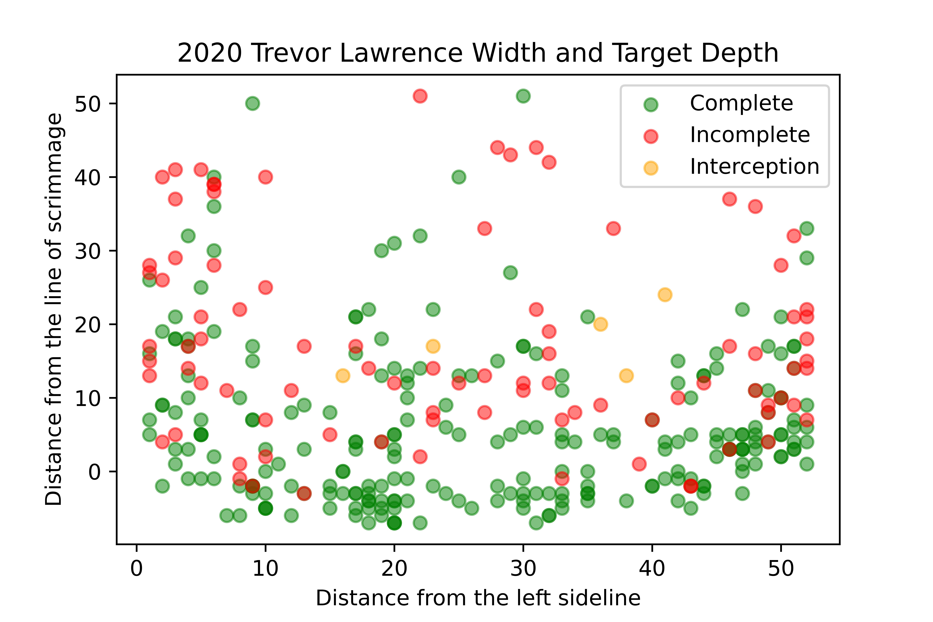
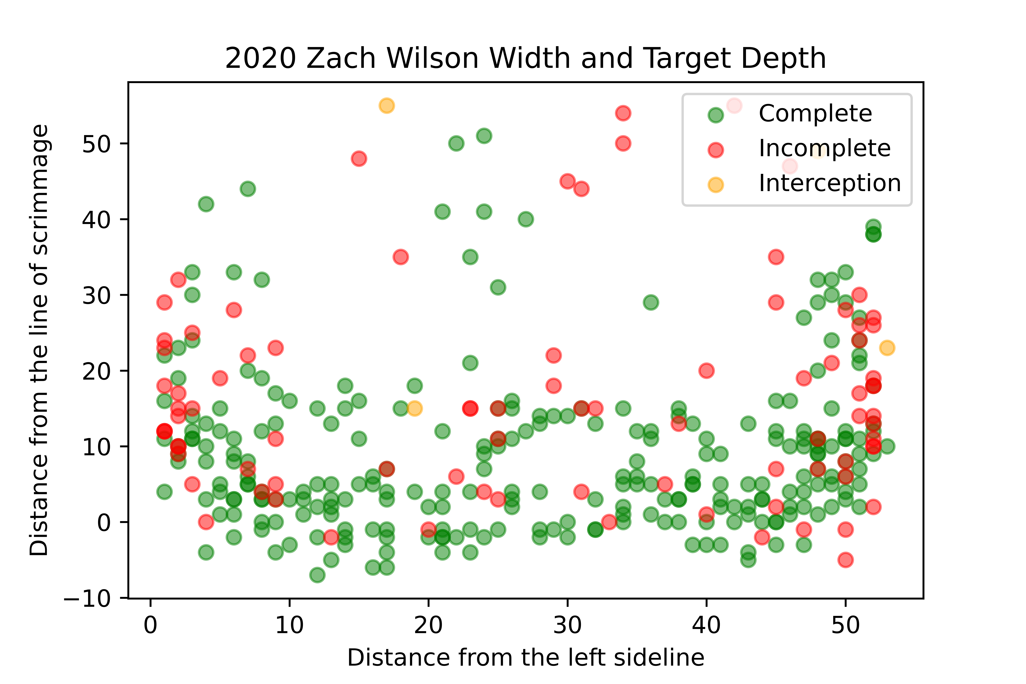
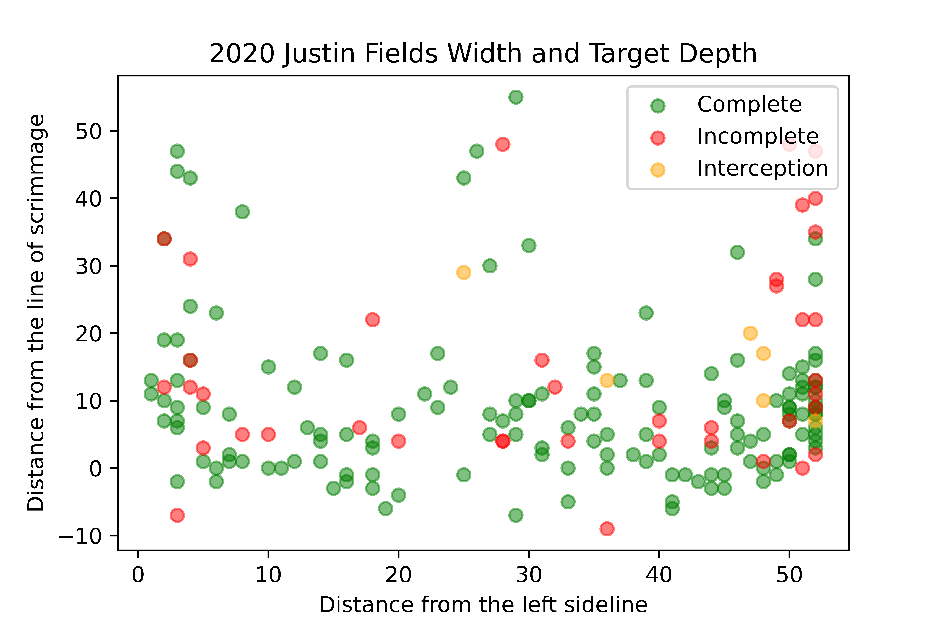
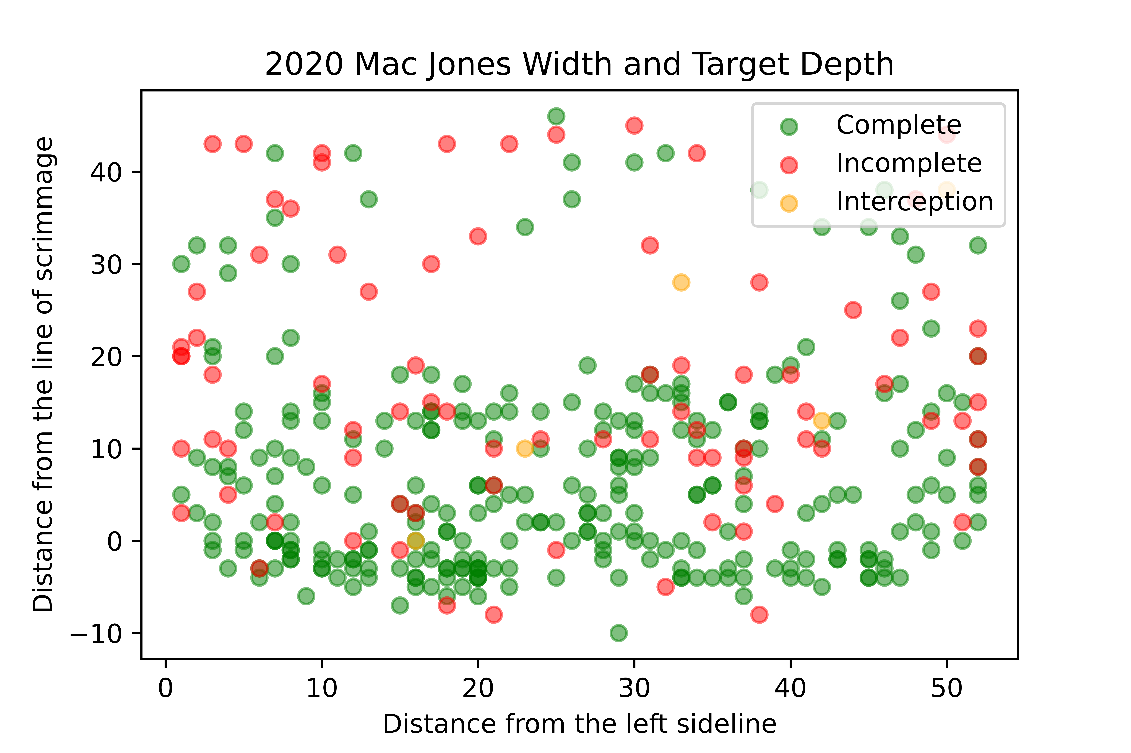

Slide 7
Defensive Players
Behind offense in advanced metrics
Key metrics for defensive players:
Tackles (and missed tackles)
Sacks
Interceptions
Forced Fumbles

Slide 8
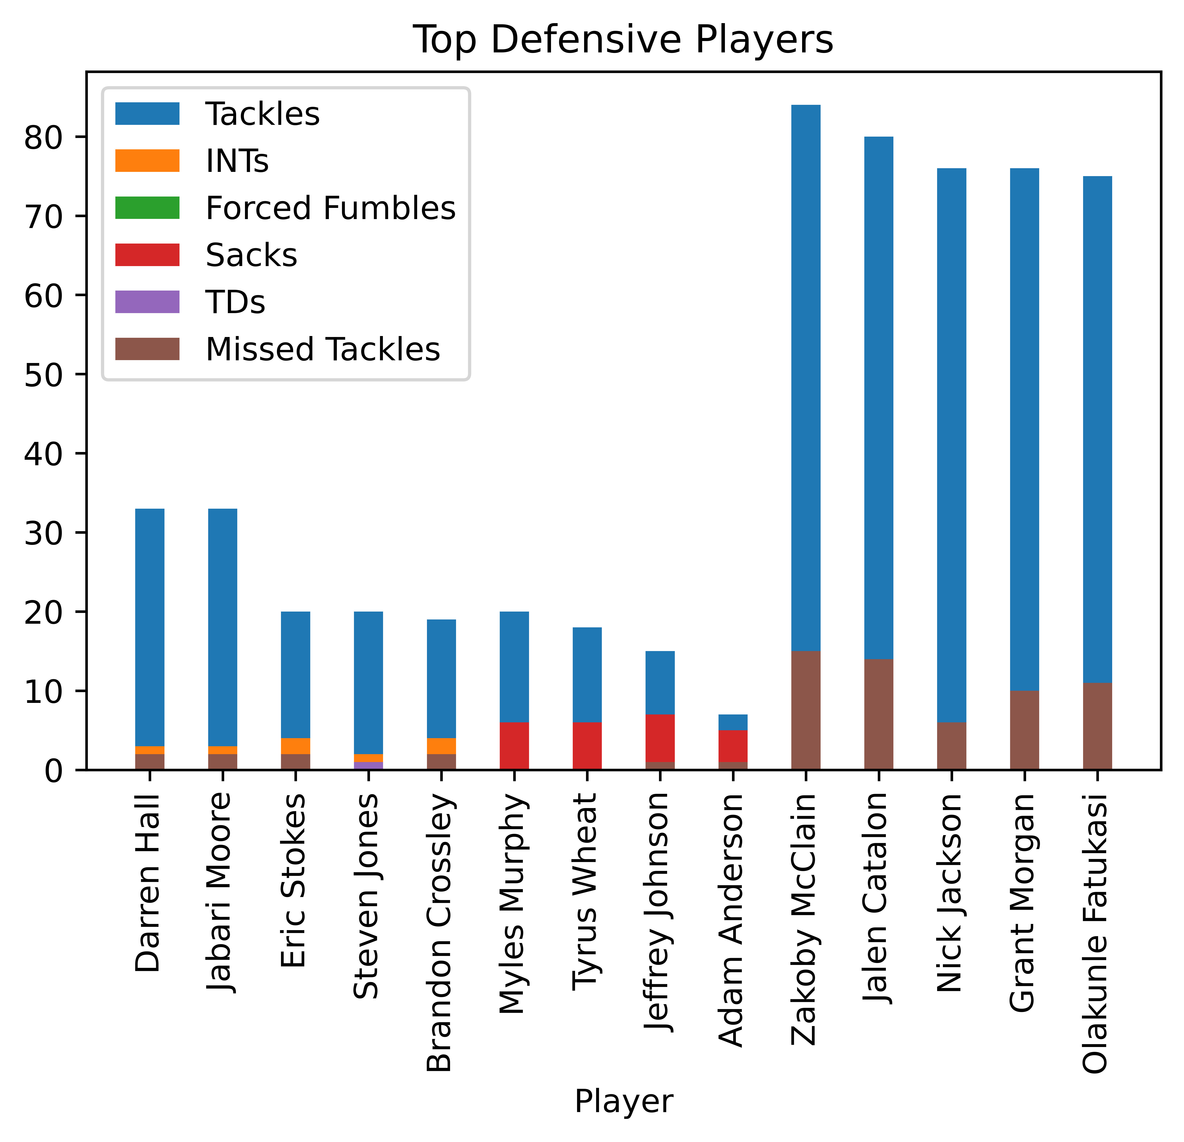

Slide 9
Kickers
Average margin of victory for NFL games is 3 points
Number one stat correlated with winning: points scored
Top 8 scorers in 2020 were all kickers

Slide 10
Kickers

Slide 11
Conclusion
Work is reproducible for year over year analysis
Great starting points for deeper analysis
Save teams money, and time
Increase efficiency

